Slide 1

Cessation Programs

Slide 2
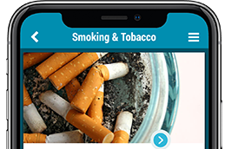
Three Cessation Programs
WASHINGTON STATE QUITLINE
2morrow health smartphone app
This is quitting

Slide 3
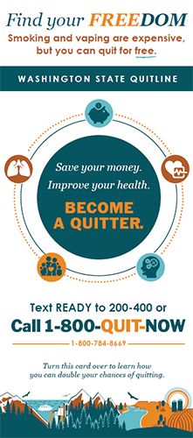
Washington State Quitline
You can get free, confidential, one-on-one counseling from a Quit Coach, and may be eligible for free medication to help you quit smoking, vaping, or other tobacco.
Register by:
Calling 1-800-QUIT-NOW (1-800-784-8669);
Visiting quitline.com; or
Texting READY to 200-400.
Not ready just yet? Click here to learn more about the Quitline and other counseling options.

Slide 4
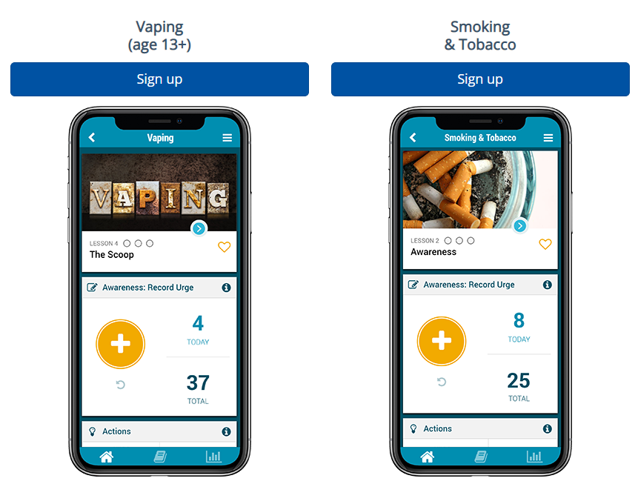
2Morrow Health smartphone app
2Morrow Health is a free, anonymous, self-guided app-based program that teaches you how to deal with unhelpful thoughts, urges, and cravings caused by nicotine. You can create a profile, select a quit date, and track your progress in quitting vaping, smoking, or other tobacco use.
Click here to learn more about the 2Morrow Health app.

Slide 5
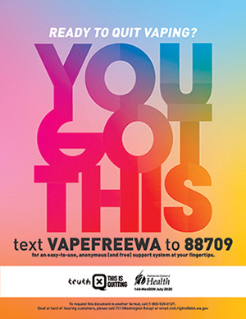
This is Quitting
This is Quitting is a new text-to-quit vaping program for young people ages 13-24. Text VAPEFREEWA to 88709 to sign up.
Click here to learn more about This is Quitting.

